Slide 1
Theme: 3. Keyboards

Slide 2
A computer keyboard is an input device used to enter characters and functions into the computer system by pressing buttons, or keys. It is the primary device used to enter text. A keyboard typically contains keys for individual letters, numbers and special characters, as well as keys for specific functions. A keyboard is connected to a computer system using a cable or a wireless connection.

Slide 3
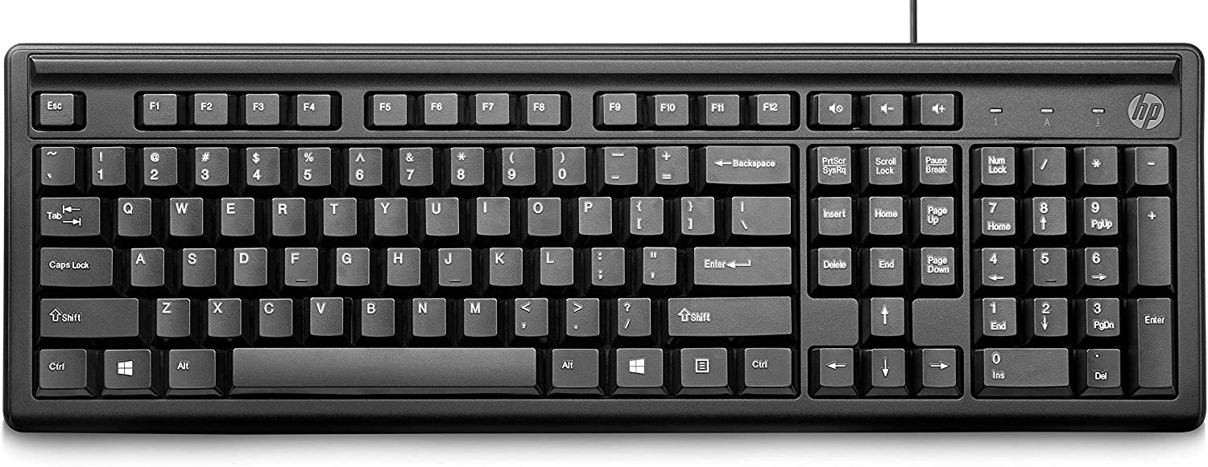
Most keyboards have a very similar layout. The individual keys for letters, numbers and special characters are collectively called the character keys.
The layout of these keys is derived from the original layout of keys on a typewriter. The most widely used layout in the English language is called QWERTY, named after the sequence of the first six letters from the top left.

Slide 4
Other sets of keys common to almost all keyboards are entering and editing keys (e.g., Enter, Delete, Insert), modifier keys (e.g., Control, Shift), navigation keys (e.g., arrows for up, down, left, right) and lock keys (e.g., Caps Lock). Additional keys are very operating system specific (such as the Windows and Apple keys).
Most keyboards also include a set of function keys at the top (F1, F2, etc.). The function keys typically perform a very specific task within a particular software application. So, what they do may depend on what you are doing on your computer at the time.

Slide 5
Most keyboards for desktop computers also contain a separate numeric keypad to the right. Even though there are numeric keys already in a row near the top, having them all close together makes it faster to enter numeric data. On smaller keyboards, like those on most laptops, these numeric keypads are typically no longer present due to space constraints.
Here, you can see a typical keyboard layout. Keep in mind that there are many different variations on this layout, although most manufacturers follow this general pattern:

Slide 6
However, this general layout has remained remarkably unchanging over the years. This has made it easy for users to transition from one computer system to the next and to use their typing skills on multiple devices.
For many tasks, you need to press more than one key at the same time. For example, to get a capital letter 'A,' you need to press the Shift key and the A key at the same time. When reading or writing instructions for how to accomplish a particular task, this would be described as 'Shift + A.' As another example, in most software applications, Ctrl + S means to save the current document. If you have been using computers for some time, you are probably familiar with a number of such combinations.

Slide 7
Want to know the most famous combination of all? Ctrl + Alt + Del, also referred to as Control-Alt-Delete. In older computer systems, this actually rebooted your computer. Sort of like pulling the power cord and plugging it back in again. In more modern versions of the Windows operating system, the combination brings up options to log off or shut down, as well as options to force a particular software application to quit. This is useful if you are not able to exit an application in a regular fashion.

